Slide 1

Sierpiński Carpet – visualization
Radosław Manak
Computer Science, 2nd year
2026-03-27

Slide 2
Motivation and problem
Visuals are important in math and graphics
They show self-similarity
They can be made with an algorithm
The project shows how recursion works

Slide 3
Idea
Divide the square into a 3x3 grid
Remove the middle part
Repeat the process for the other parts
Next steps create the picture

Slide 4
Pseudocode
drawCarpet(x, y, size, depth):
if depth == 0:
return
newSize = size / 3
remove the middle square
for each of the 8 other squares:
drawCarpet(..., depth - 1)

Slide 5
Complexity
The complexity grows very fast:
Number of parts ~ 8^n
Each step adds more detail

Slide 6
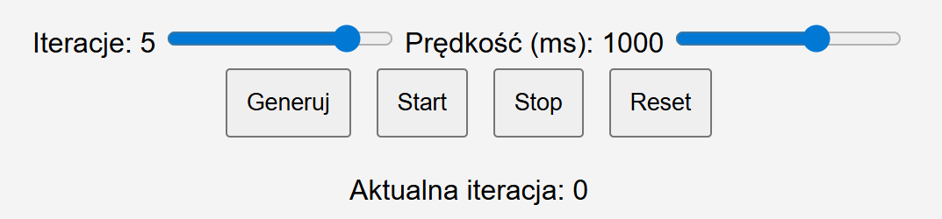
Parameters
Number of iterations
Animation speed
Controls
Start
Stop
Reset
Generate

Slide 7
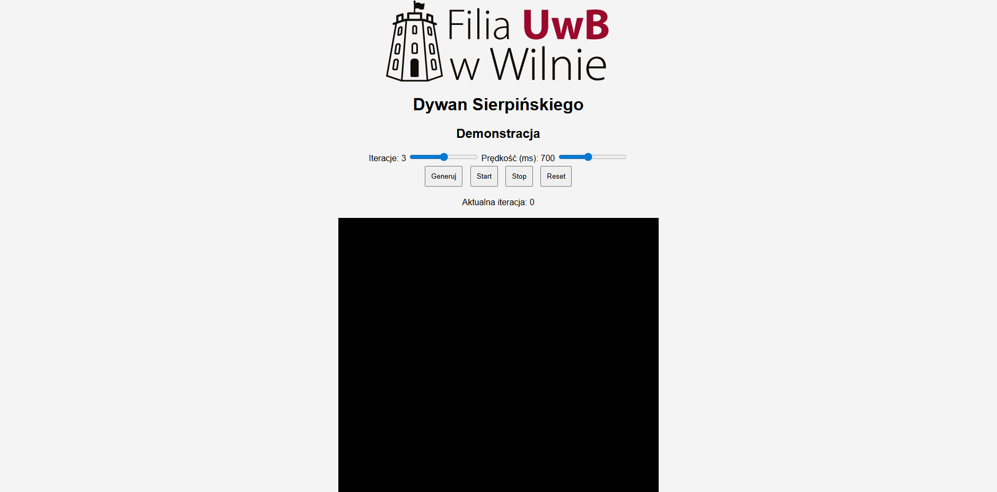
Program interface

Slide 8
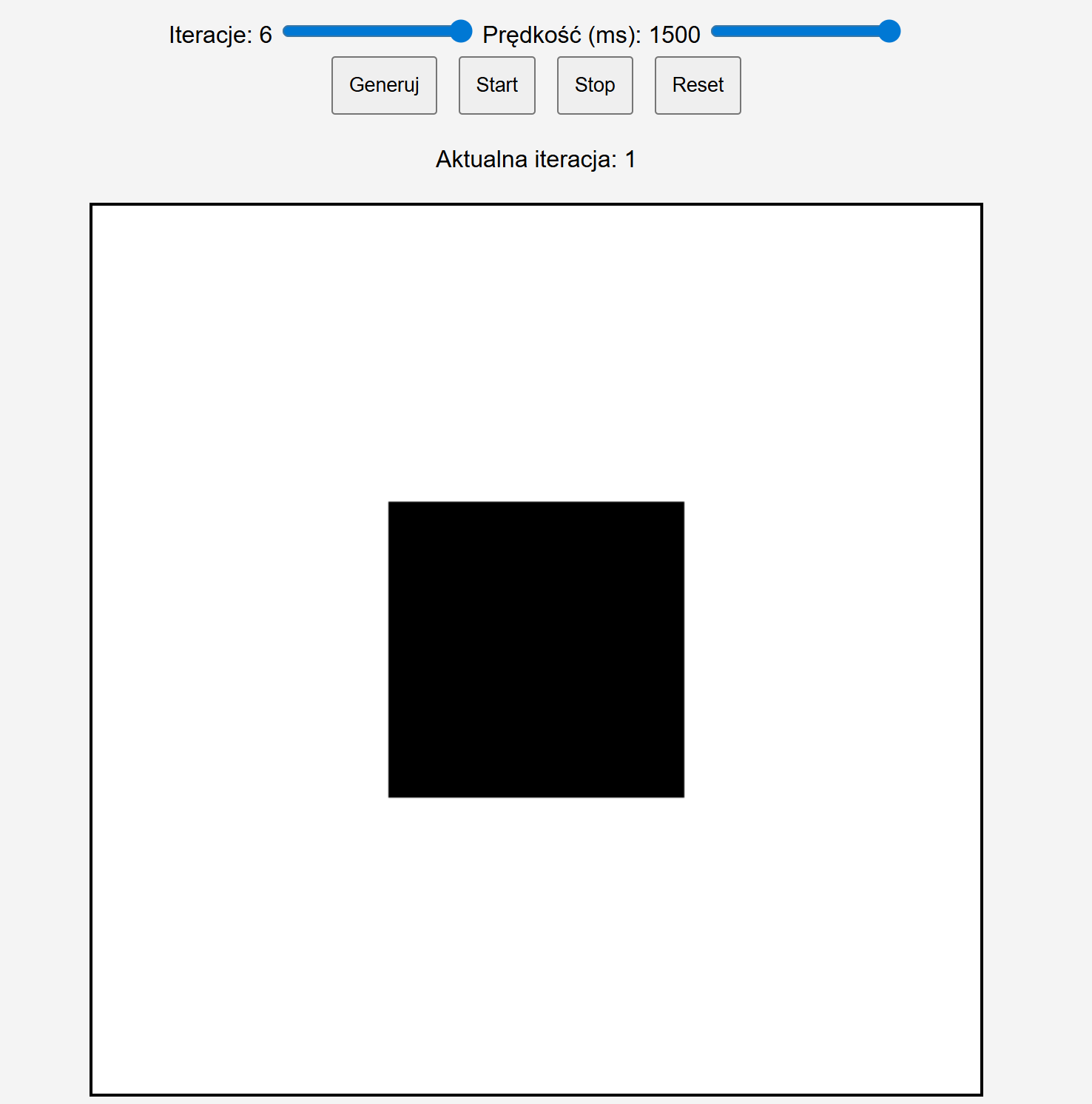
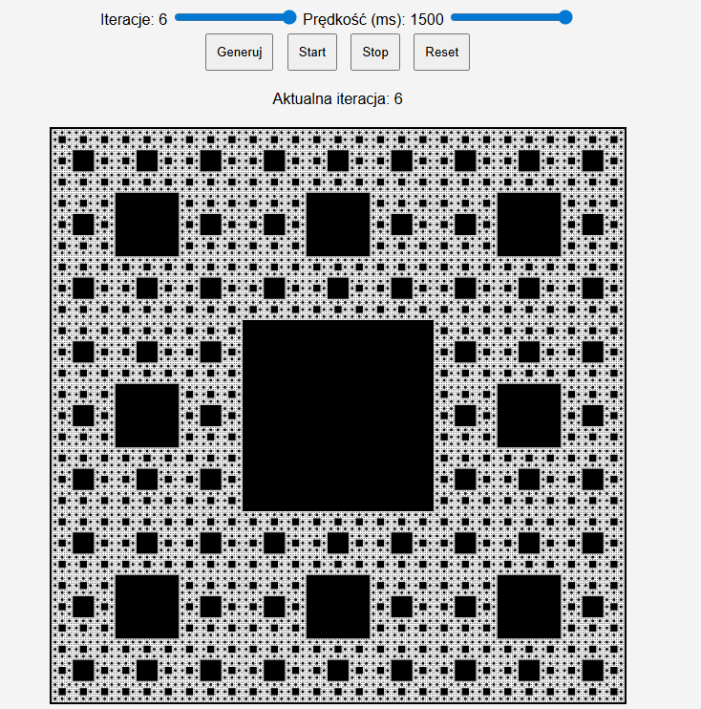
Demo

Slide 9
Summary
Benefits:
simple algorithm
math visualization
interaction
Weak point:
high complexity with many iterations
Use:
education
computer graphics

